Slide 1
KENT GARDENS PTA MTG 9.30.15

Slide 2
AGENDA
Approve mtg Minutes
Communications
Fundraising update
Events update
Treasurer’s update
Principal up-date – Mrs. McGrath
Q&A
PLEASE REFRAIN FROM ASKING QUESTIONS UNTIL Q&A

Slide 3
Communications.
The PTA will be going GREEN
Friday Folder insertions will be limited to monthly calendar and ASA
Sign-up for our Electronic Newsletter: The Roar
Go to : www.kentgardenspta.com, Click the “Get Involved” tab, Click join e-mail list
Like us on Facebook and Instagram
Check out website for up-dated information

Slide 4
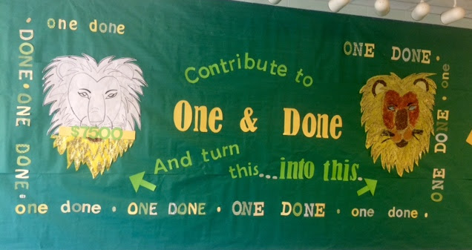
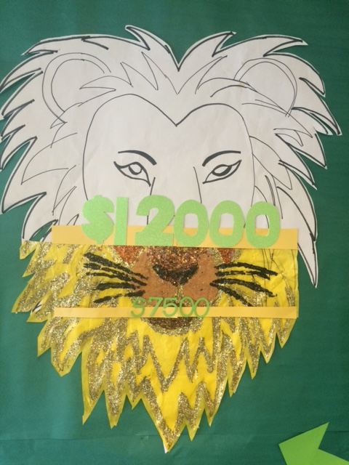
One & DONE
Goal of 100% PARTICIPATION – any amount you can contribute helps!
With One & Done we hope to eliminate additional fundraising efforts!

Slide 6
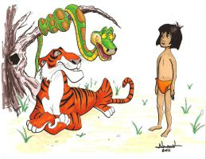
Enrichment programs
After School Academies
Elise Moss and Courtney Manzel – thank you!
Classes begin on October 5th
Chess Club
Chair Wanted
Musical Theater Club
Odyssey of the Mind

Slide 7
It’s easy to find Box Tops. In fact, you may have some in your home right now! Clip Box Tops from your favorite products and turn them into your school today! Box Tops are each worth 10¢ and they add up fast!

Slide 8
You link your Giant bonus card online, and the school automatically earns money whenever you shop.
You only need the first 3 digits of your last name, and the 12 digit number found on the back of your card to sign in. Here is the school code which will make it even faster: 01994. It’s easy! Here is the link: http://giantfood.com/aplus/register-card/
We currently have 85 enrollments and would love to increase that number!
Questions: Contact Tamara Lucas or Amber Syed

Slide 9
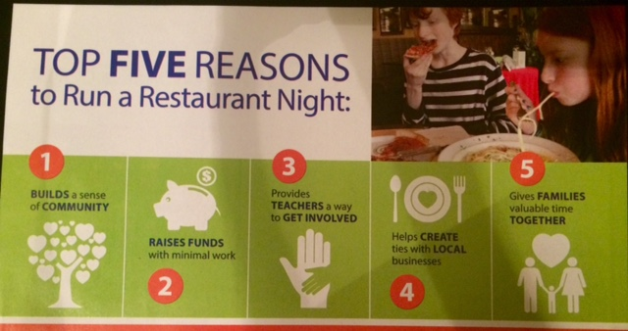
Family Dinner Night
Thank you to the families and teachers that joined us at Elevation Burger!

Slide 10
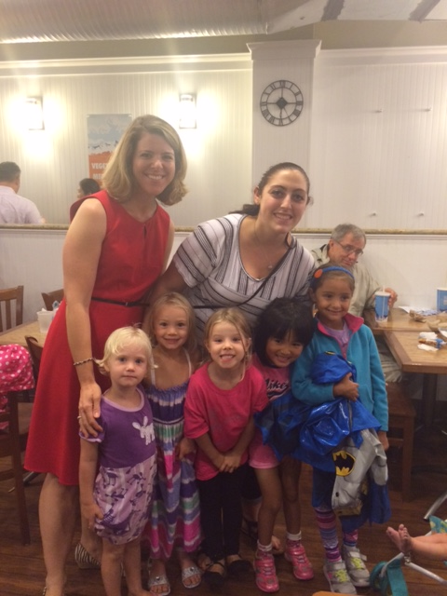
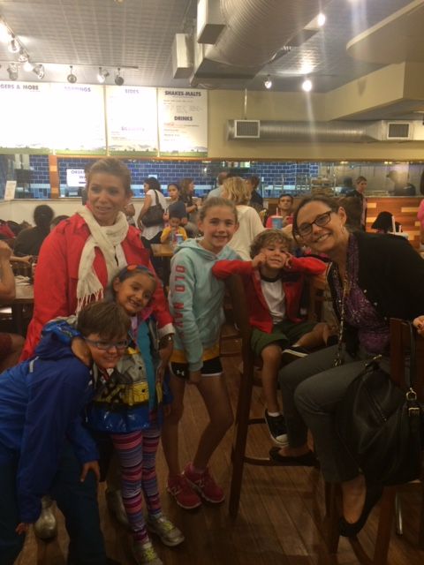
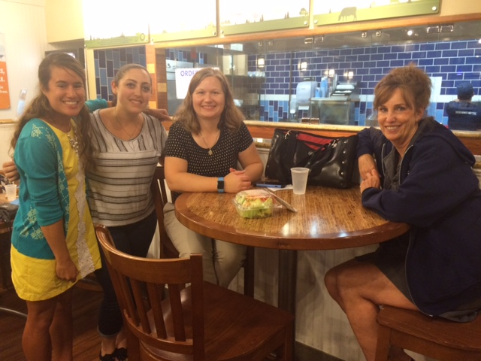
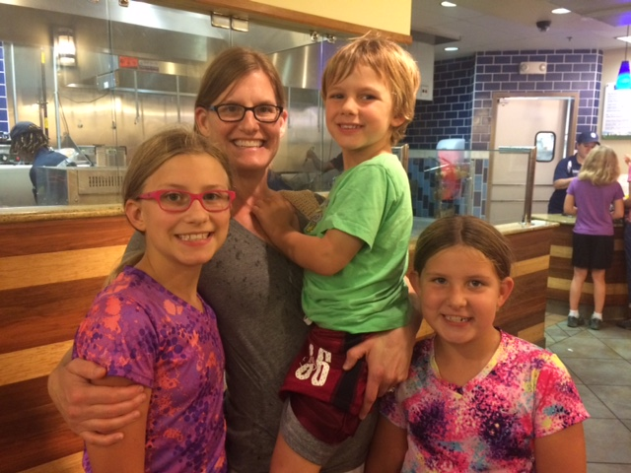
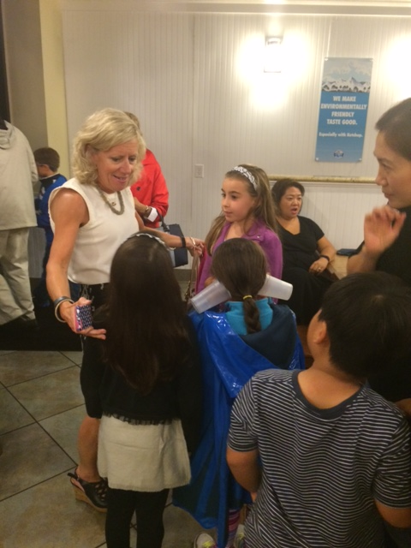

Slide 11
Pop Corn Club
Kent Gardens Tradition – popcorn delivered the first Friday of every month
Registration is online only ($10 per student): http://www.kentgardenspta.com/programs/popcorn-club/
Our first pop is Friday, October 2nd
Also – we always need extra help popping, bagging and delivering this very popular program! If you have even just an hour to spare, we could use your help! Just show up at the cafeteria the first Friday of the month between 8:30am and 10:00am, and we will put you to work!
Point of contact is Paige Himes (phimes6@verizon.net)

Slide 12
National Walk-to-School Day Wednesday, October 7th
Be active, stay healthy and wake-up your brain!!
Walk or ride your bike to school on Oct. 7 and arrive at school on time
Park and lock your bike at the bike racks or along the playground fence
From 8:20 - 8:50 am get your sticker and enjoy KIND BARS energy snacks
Enter Raffle to win a water bottles donated by REI
Start your day in a good mood!
Great team – Karen Samonettie, Leslie Turley, and Gayle Carter

Slide 13
FAMILY MOVIE NIGHT
Friday, October 16th
Despicable Me 2
Dining options will be available – look for info in The Roar
Volunteers needed to plan and help at event

Slide 14
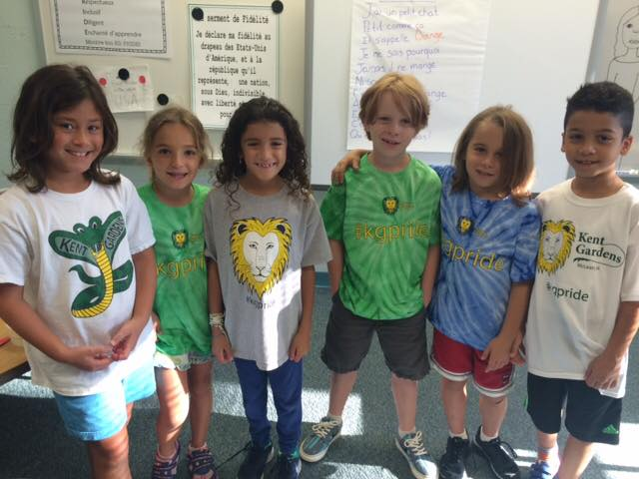
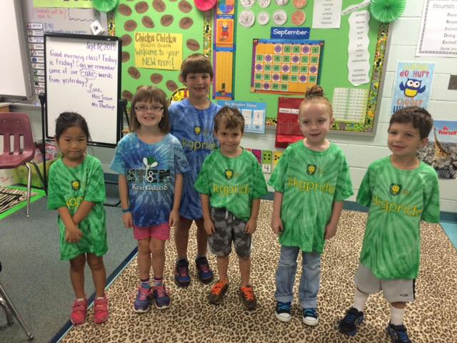
#KGPRIDE SPIRITWEAR
Every Friday show your #KGPRIDE for school spirit DAY
We love seeing all the kids in their KG Swag – thanks for your support!!!
Thank you to Amber Syed for designing

Slide 15
FCPS Parent Resource Center
Chair: Connie Howell (conniesanabria@yahoo.com)
Up-Coming Events:
10.02.2015 | Mind in the Making - Focus & Self-Control REGISTRATION IS NOW CLOSED
10.16.2015 | Bully Busters
10.19.2015 | iCan Bike After-School Program
10.20.2015 | Strategies to Support Secondary Students with Dyslexia
10.23.2015 | Fidgety, Forgetful & Unfocused
10.24.2015 | Aim 4 Success Conference
10.27.2015 | Moving on to Life in the Community
11.06.2015 | Mind in the Making - Perspective Taking REGISTRATION IS NOW CLOSED
11.13.2015 | Strategies to Support Elementary Students with Dyslexia
11.14.2015 | Future Quest 2015 - Register now!
11.18.2015 | Introduction to Special Education
11.20.2015 | Raising Your Kids by Keeping Your Cool REGISTRATION IS NOW CLOSED

Slide 16
FLEX – (kim_marinus@msn.com)
We need a couple more students in the French FLEX level 3 class (grades 4-6) to keep the class. It is an especially good resource for families that do not speak French at home. It is good, too, for 6th grade students interested in taking the French class for immersion students at Longfellow next year.
But my child is in already in the immersion program. Don't they already get enough French in school? Here are some benefits of the classes:
The FLEX classes teach topics that may not be covered during the school day, such as: animals, food, parts of the body, family, clothing, grammar, verb conjugation, etc.
The FLEX classes provide a smaller environment than the classroom allowing for more one-on-one with the teacher.
The FLEX classes help reinforce the French they learn during the school day.
The FLEX classes provide more reading and writing opportunities than during the school day.

Slide 17
Legislative liaison
Up-date from Jeff Heilbraun

Slide 18
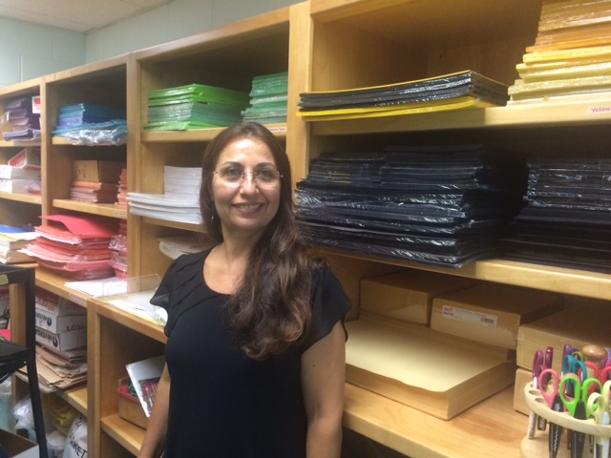
PTA Funds sept-oct
Funding Field trips
Cox Farms – Kindergarten Oct. 16th
National Building Museum – 2nd Grade French Immersion – Oct. 23rd
National Building Museum – 2nd Grade General Ed – Oct. 28th
Purchased Art Supplies
Purchased Kindergarten classroom supplies
Purchased PE Equipment

Slide 19
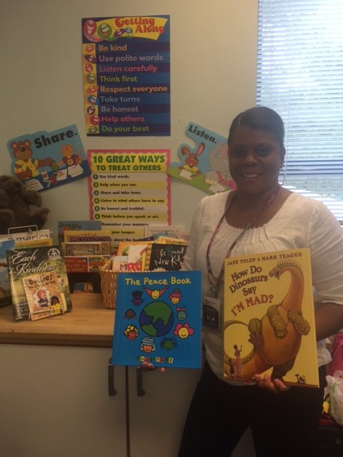
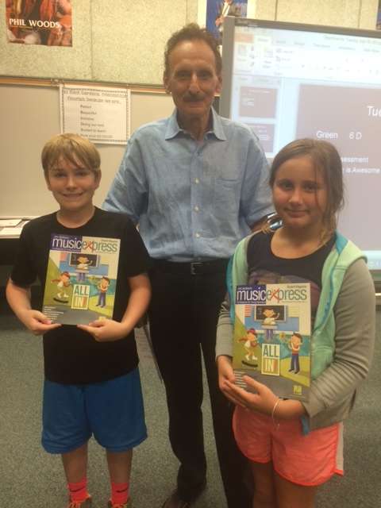
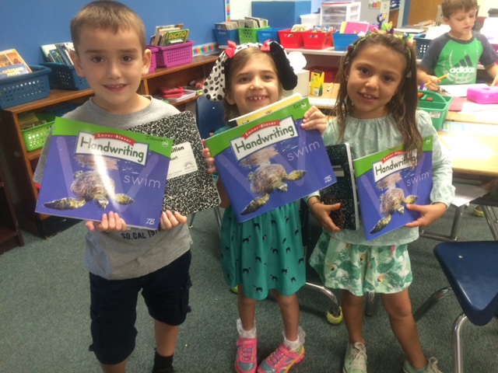
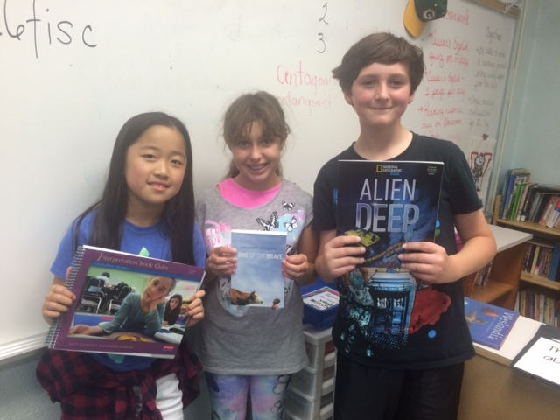
PTA FUNDS SEPT- OCT
Purchased Guidance Counseling Supplies
Purchased French classroom supplies
Purchased Music Magazine Subscription for the kids
Purchasedd Writing and Reading Guides for each grade level

Slide 20
TREASURER’S REPORT
August Financials
September Financials

